Slide 1
User Behaviour Analysist
Dini Anggriyani

Slide 2

Background
This report aims to analysing user behaviour based on the data given including but not limited to credit limitation, merchant city, gender, and income amount

Slide 3
Data Source
Cards_data => Information about user card
Transactions-data => Transaction data
User_data => user information
Tools : python + SQL + GSheet + Looker

Slide 4
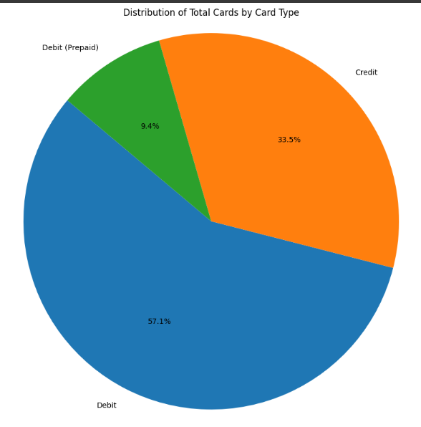
Credit Limit Based On Card Types
Debit has higher average limit compared to other card types.

Slide 5
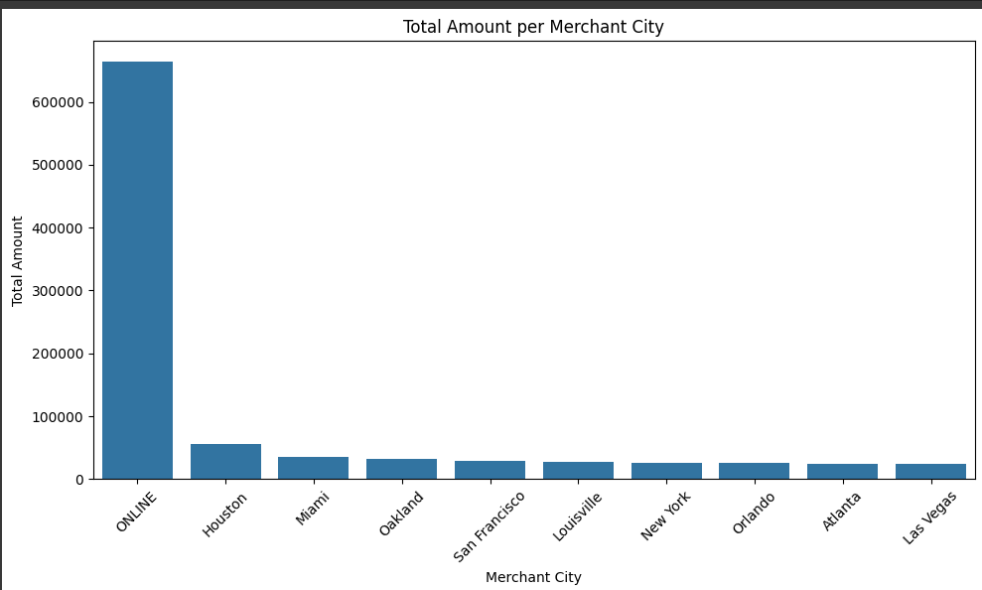
10 Merchant City with The Most Amount
Houston, Miami, and Oakland are the top 3 cities with the most amount outside the online merchant.

Slide 6
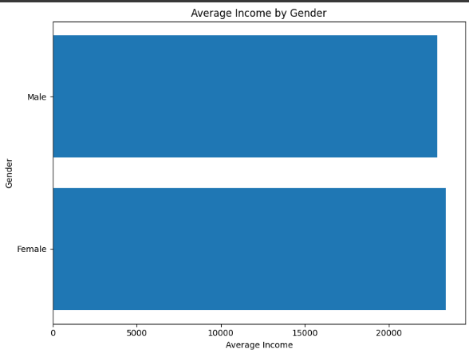
Income Amount Based On Gender
Female has slightly higher average income than Male.

Slide 7
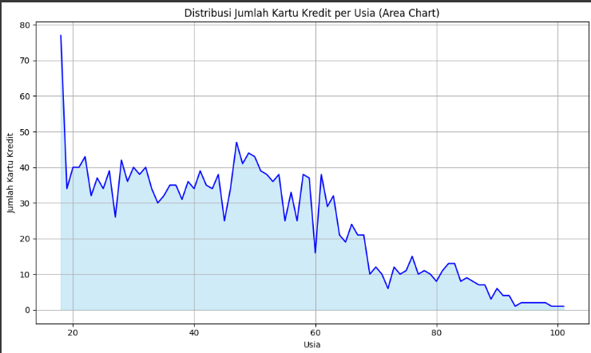
Number of Credit Card Based on Age
The Younger a man is, the more they tend to have more credit cards. It can be influenced by the life style of the young man.
Link for the looker studio can be accessed here: https://lookerstudio.google.com/reporting/b4b48fcc-af3f-43d4-af4c-9234df96ed12

Slide 8
Thank You!

